Slide 1
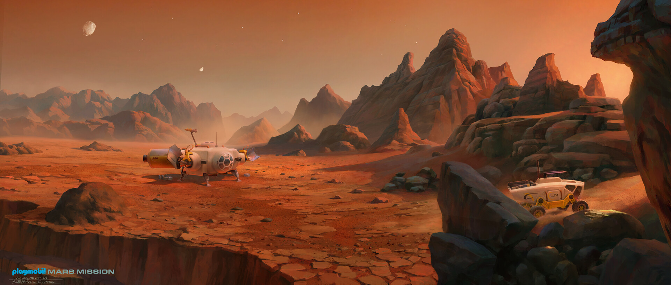
Mission To Mars
Webpage displaying Mars information scraped from various websites

Slide 2
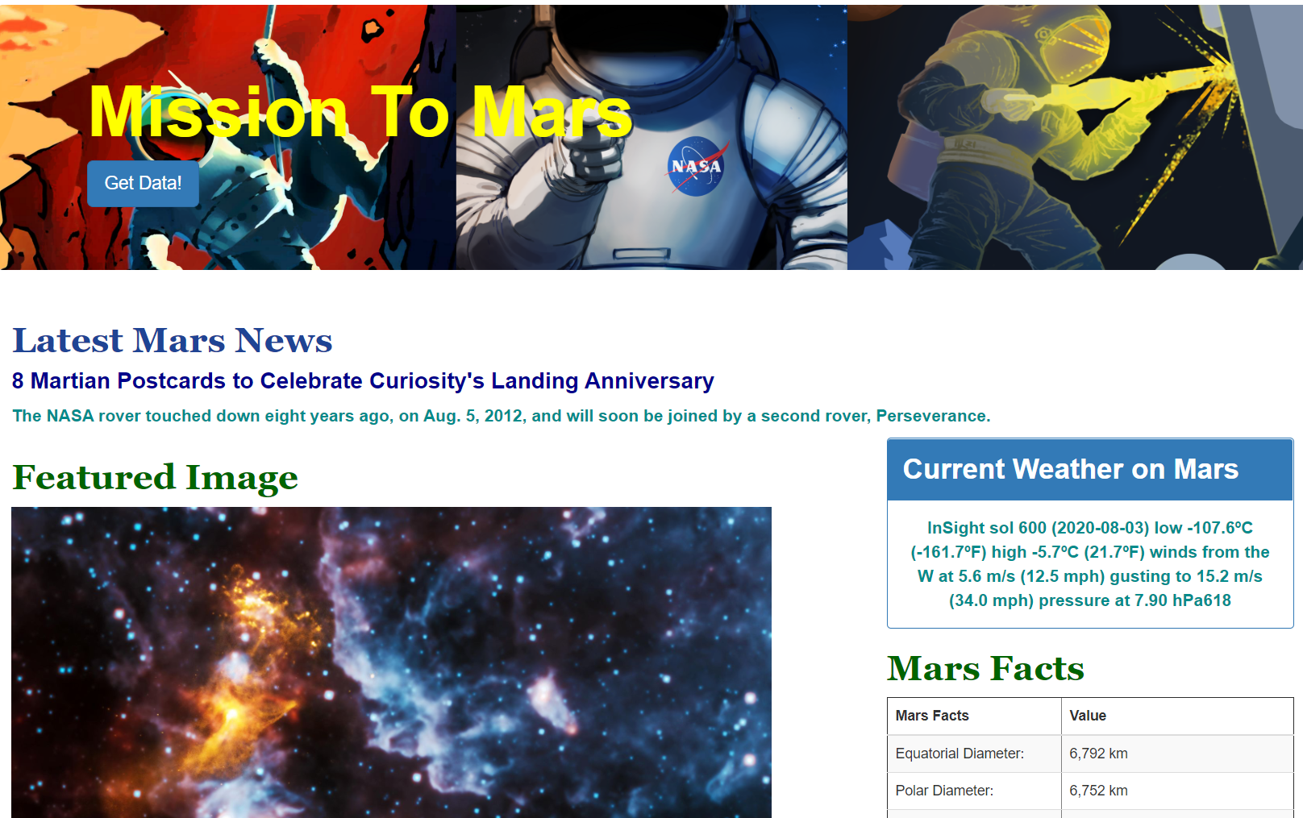
Landing page : Jumbotron

Slide 3
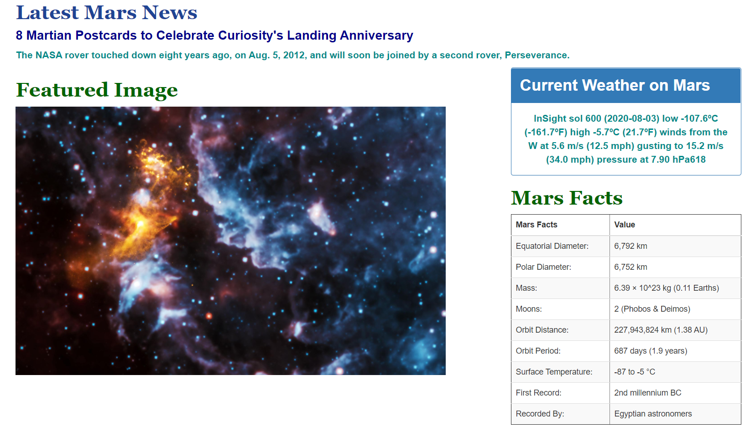
Screen displaying (a) news headline, (b) first paragraph, (c) featured image, (d) latest weather tweet and (e) facts from the red planet :

Slide 4
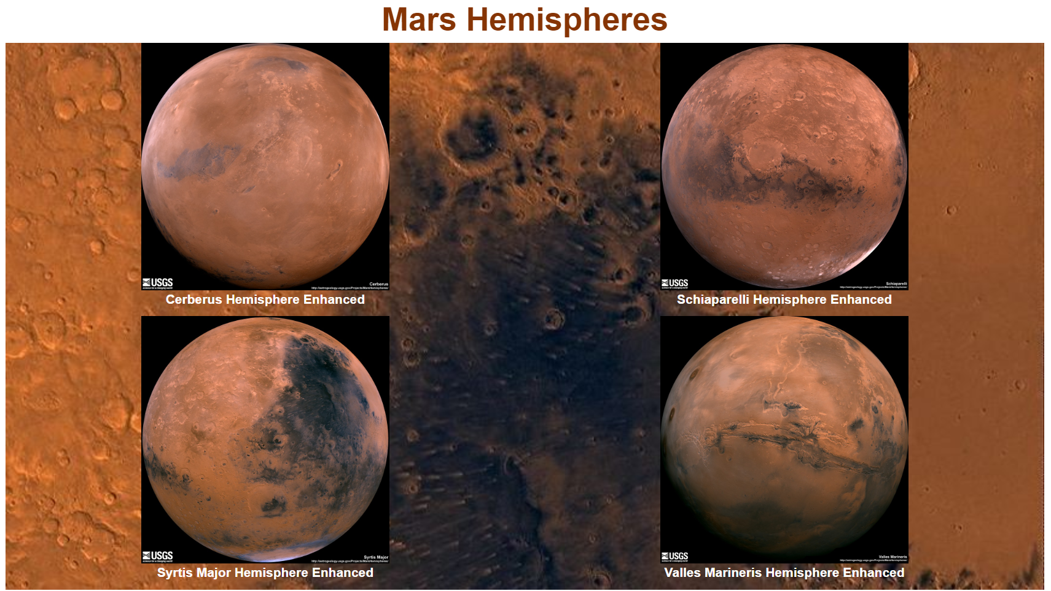
Screen displaying images of the four hemispheres of Mars

Slide 5
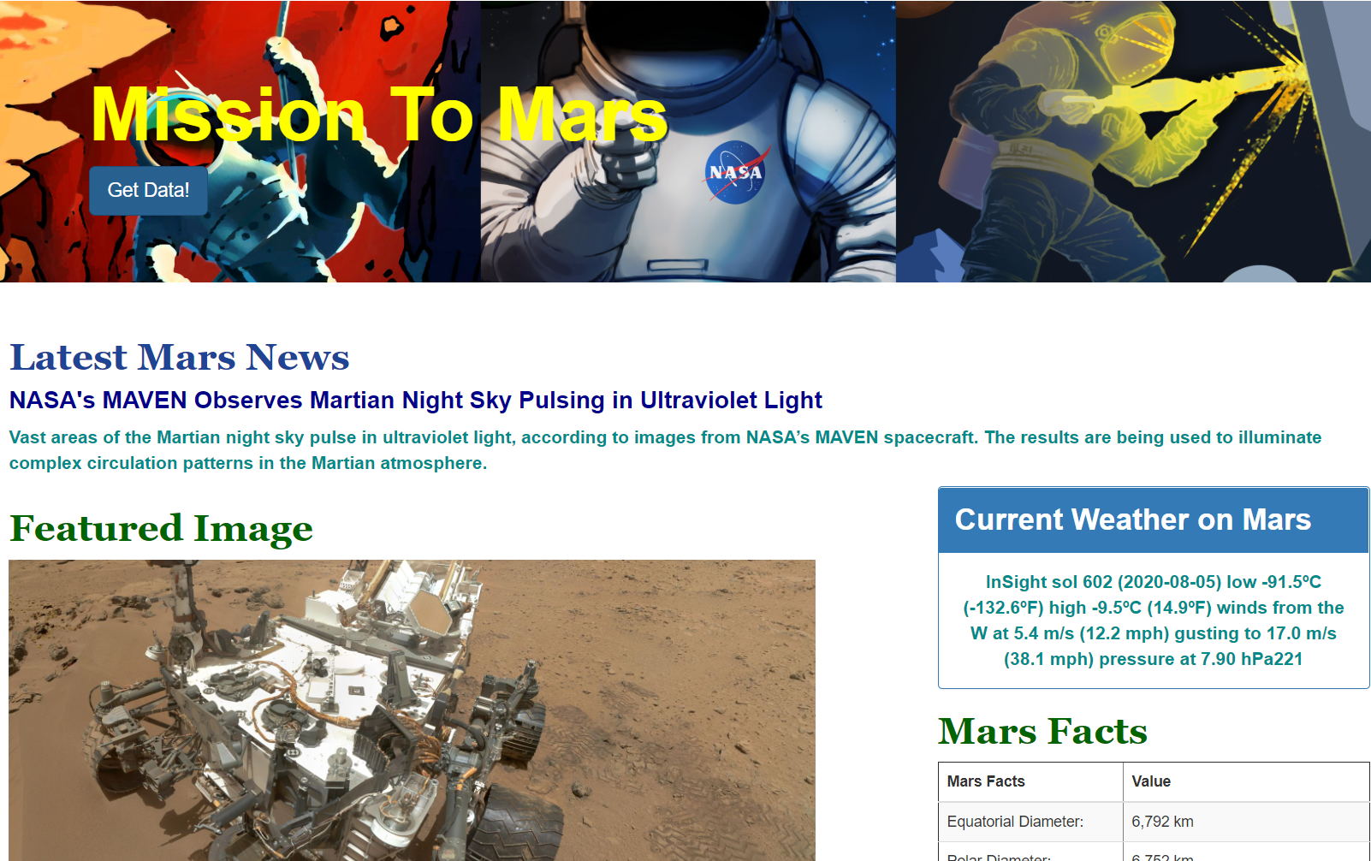
Press the “Get Data!” button
Wait for few minutes (some pages take time to load and the scraper sleeps waits for 2s before scraping to ensure the complete browser has loaded ) while the app scrapes data from the web.
Website is updated after scrape is complete

Slide 6
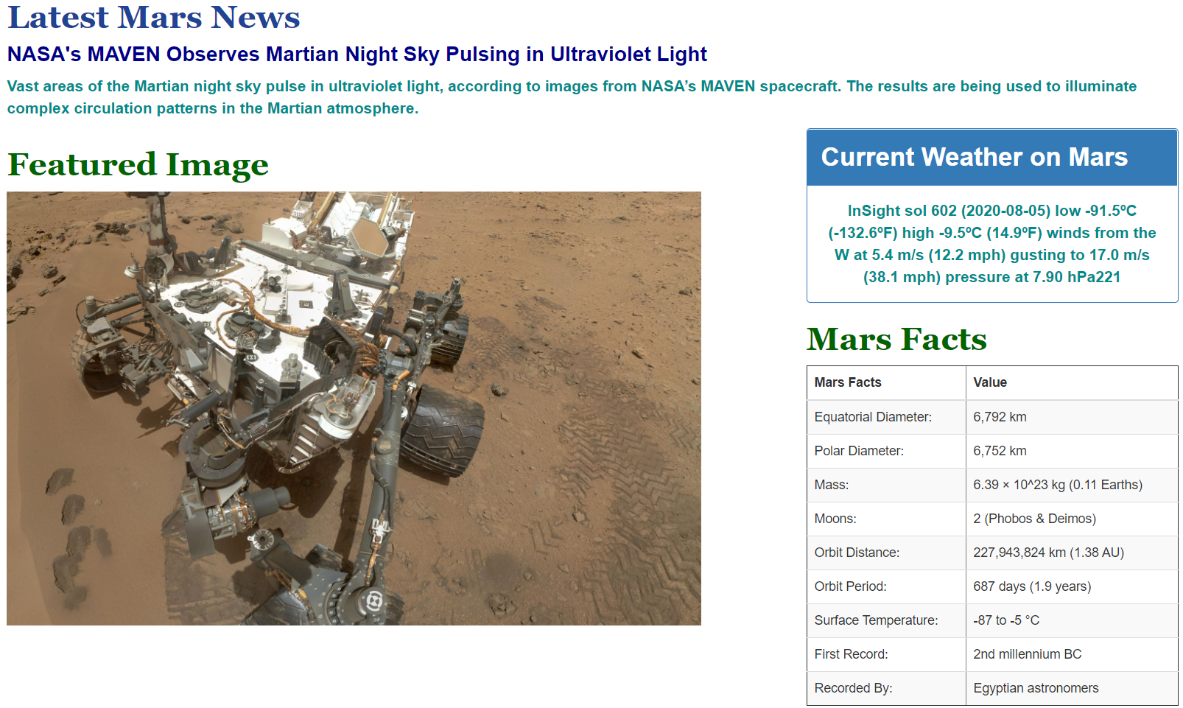
Screen displaying updated information :

